Slide 1
Sequence Diagram
By: Keith Jacobson

Slide 2
What is it used for?
Sequence diagrams emphasize the time ordering of messages.
They show a succession of interactions between classes or object instances over time.
Sequence diagrams are used to show the overall pattern of the activities or interactions in a use case.
Each use case may create one sequence Diagram.

Slide 3
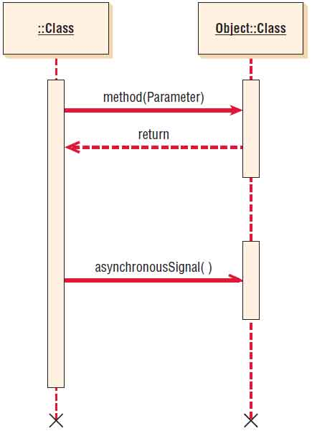
Symbols used, and example of how to create it:
objectName: | A name with a colon after it represents an object.
:class | A colon with a name after it represents a class.
objectName:class | A name, followed by a colon and another name, represents an object in a class.

Slide 4
::newStudent
UserInterface
::Student
::Classes
::Degree
Initialize()
return studentNumber
selectClasses()
return selectedClasses
selectDegree()
return degreeAdvisor
studentComplete()

